Slide 1



Django (Multi Brand Mobile Site)
Bhai Parmanand Institute Of Business Studies
Guided By:
Ms. Deepak Sharma sir
Submitted by:
Anil Kumar Vishwakarma (00311404420)

Slide 2
Introduction :
Project profile
Project Introduction

Slide 3
Project Profile
Project Name : Multi brand mobile site
Project type : Website
Project Objective : Provide best rate of market less price mobile on covid -19 situation
Project Guide :
Front end : JavaScript ,html ,bootstrap ,CSS ,jQuery
Back end : Django -python
Team member : 1
Summited by : Deepak Sharma sir

Slide 4
Project introduction
This is the ecommerce site for buy mobile phone
All the specification are the given by the mobile site
WHEN need then mobile then go for the site and by the
Mobile phone
It is very secured mobile site
All the data is the user information are managed form stored
The main aim of the mobile site in best rate provide mobile

Slide 5
Environmental description
Hardware and software requirement
Tools and technologies

Slide 6
Hardware & Software Requirements
CLIENT SIDE
SERVER SIDE
DEVELOPMENT SIDE
Tools and technology
Core technology
Documentation tools
Development Tools
Extra technology

Slide 7
CLIENT SIDE
Hardware Specification
Ram: 2 GB(Minimum)
Rom: 2 GB
Software Specification
Internet enabled device with Web Browser

Slide 8
SERVER SIDE
Hardware Requirement
Ram: 4 GB(Minimum)
Rom: 1 TB
Software Specification
PyCharm IDE
SQlight3

Slide 9
Developer side
Hardware Configurations
Ram | 1GB
Processor | I3 Intel 5th generation
Hard ware | 500GB
Software Configurations
Operating System | Windows 8 above
Front end | HTML ,BOOSTRAP ,JAVASCRIPT
BACKEND | PYTHON(SQLIGHT3 IN DATABASE)

Slide 10

PROPOSED SYSTEM
Aim & Objective
Expected advantages
Scope of the Proposed
This Photo by Unknown Author is licensed under CC BY

Slide 11
Aim & objective
The aim of the proposed system is the develop a system of improved.
The proposed system can overcome all the limitations of the existing system.
The exiting system has several disadvantages and many more difficulties to work well. The Proposed system tries to eliminate or rescued this difficulties to some extent.
The proposed system will help the user to reduced the working and mental confect.

Slide 12
ADMIN
Admin has all authority.
Admin can manage his/her own Profile.
Admin can approve Service and maintain their details.
Approve customers and maintain Customer’s details.
Admin can view information related to register services professionals and services seeker.
Category and Subcategory details are managed by the admin.
Admin can view the services request of the Customer.

Slide 13
Customer
Can register as Customer
The login register person
The book our schedule
Buy the new phone
Take enquire

Slide 14
Visitor
Visitor can view the services request.
When it buy the it any product then register then buy the products.

Slide 15

USE CASE DIAGRAMS

Slide 16
ADMIN USE CASE DIAGRAM
LOGIN
CONFORM ORDER
ADD PRODUCT
VIEW INQUIRY
VIEW FEEDBACK
MANAGE ORDER
ADMIN
VIEW CONTACT
LOGOUT

Slide 17
Customer USE CASE DIAGRAM
LOGIN
Book our product
See all Product
Profile update
Five feed Back
Track order
customer
Contect for particular product
LOGOUT

Slide 18
Visitor USE CASE DIAGRAM
Register
contect
See all Product
Five feed Back
LOGOUT
visitor

Slide 19

TABLE STRUCTURE

Slide 20
Table : auth_user description: store admin information
fieldname | Datatype | Relationship | description
id | integer
password | Varchar(128)
Last_login | datetime
Is_superuser | bool
username | Varchar(150)
Last_name | Varchar(150)
email | Varchar(128)
Is_staff | bool
is_active | bool
Date_joined | datetime
First_name | Varchar(158)

Slide 21
Table : auth_permissions description: store admin permissions information
fieldname | Datatype | Relationship | description
id | integer
content_type | integer
codename | Varchar(150)
name | Varchar(150)

Slide 22
Table : auth_user_group description: store admin information
fieldname | Datatype | Relationship | description
id | integer
User_id | integer
Last_login | integer

Slide 23
Table : auth_user_groups description: store admin_user_groups information
fieldname | Datatype | Relationship | description
id | integer
User_id | integer
Permission_id | integer

Slide 24
Table : auth_user_user_permissions description: store admin user user information
fieldname | Datatype | Relationship | description
id | integer
User_id | integer
Permission_id | integer

Slide 25
Table : auth_user description: store admin information
fieldname | Datatype | Relationship | description
id | integer
User_id | integer
Permission_id | integer

Slide 26
Table : django_admin_log description: store admin information
fieldname | Datatype | Relationship | description
id | integer
Action_time | Varchar(128)
Object_id | datetime
Object_repr | bool
Change_message | Varchar(150)
Content_type_id | Varchar(150)
User_id | Varchar(128)
Action_flag | bool

Slide 27
Table : Django_content_type description: store content information
fieldname | Datatype | Relationship | description
id | integer
app_label | Varchar(100)
model | integer

Slide 28
Table : Django_migrations description: store content information
fieldname | Datatype | Relationship | description
id | integer
app | Varchar(100)
name | Varchar(100)
applied | datetime

Slide 29
Table :Django_session description: store admin information
fieldname | Datatype | Relationship | description
session_key | Varchar(120)
session_data | text
expire_date | datetime

Slide 30
Table :ecom_feedback description: store customer feedback information
fieldname | Datatype | Relationship | description
id | varchar(120)
name | Varchar(120)
feedback | text
date | datetime

Slide 31
Table :ecom_orders description: store admin information
fieldname | Datatype | Relationship | description
id | integer
email | Varchar(128)
addreess | datetime
mobile | bool
order_date | Varchar(150)
status | Varchar(150)
customer_id | Varchar(128)
product_id | bool

Slide 32
Table :ecom_customer description: store admin information
fieldname | Datatype | Relationship | description
id | varchar(120)
Profile_pic | text
Address | varchar(120)
mobile | varchar
User_id | integer

Slide 33
Table :ecom_product description: store admin information
fieldname | Datatype | Relationship | description
id | varchar(120)
name | text
Product_name | varchar(120)
price | varchar
discription | Varchar(120)

Slide 34
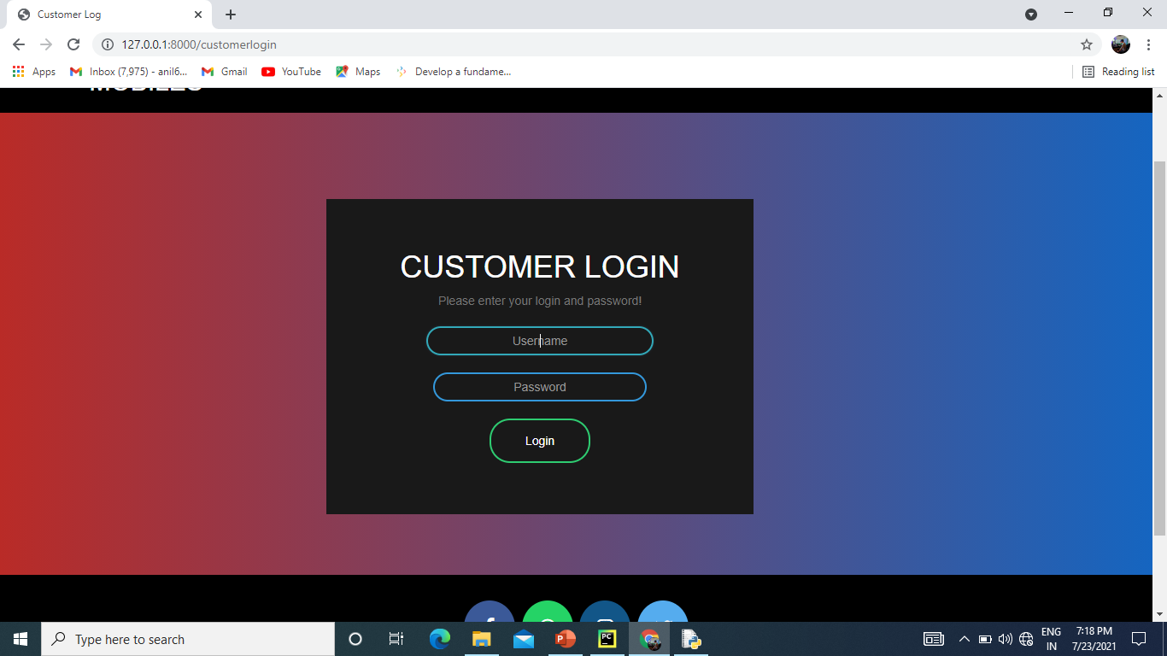
Admin Screenshot : Login

Slide 35
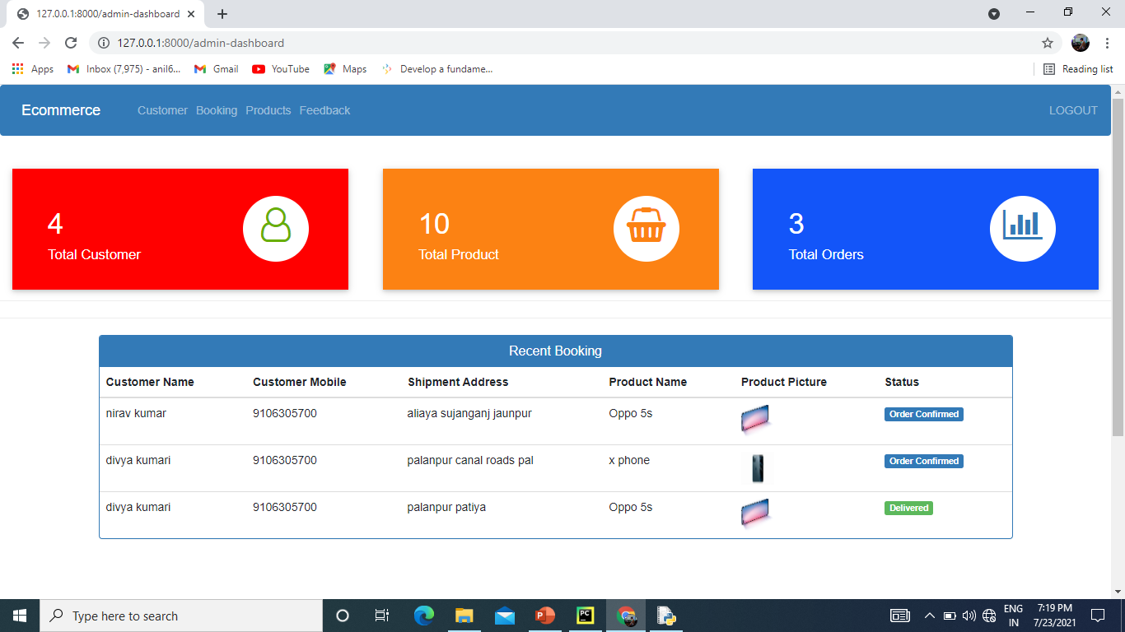
Admin Dashboard

Slide 36
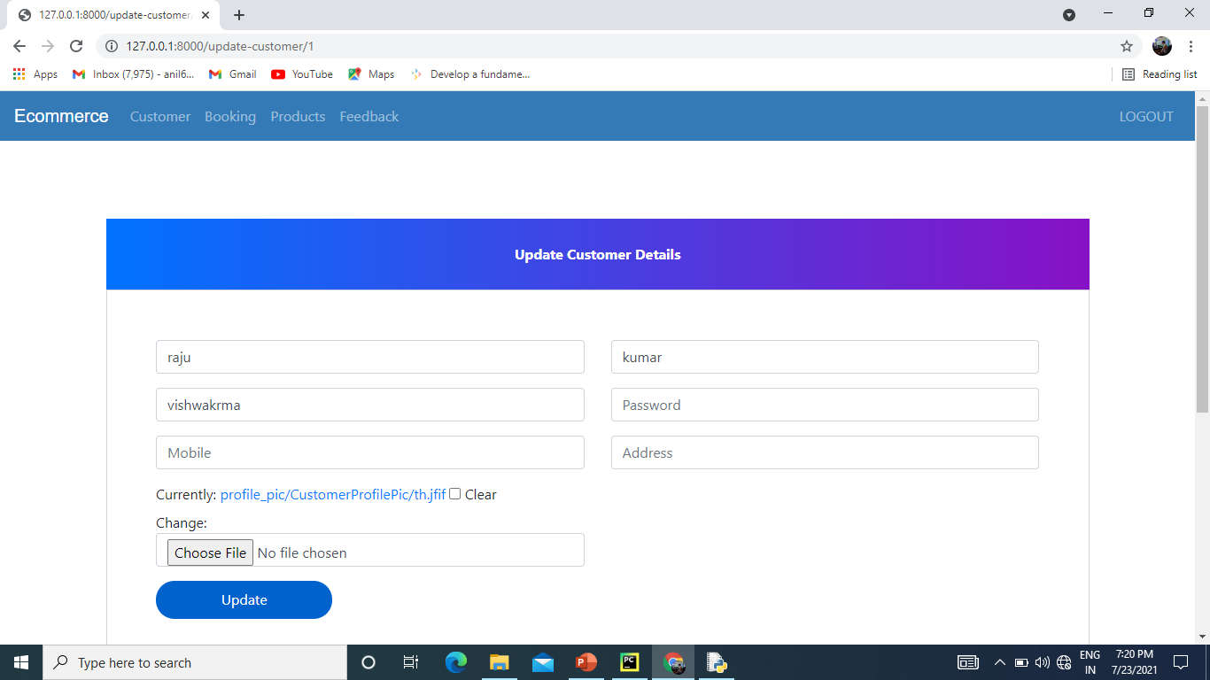
Admin Update

Slide 37
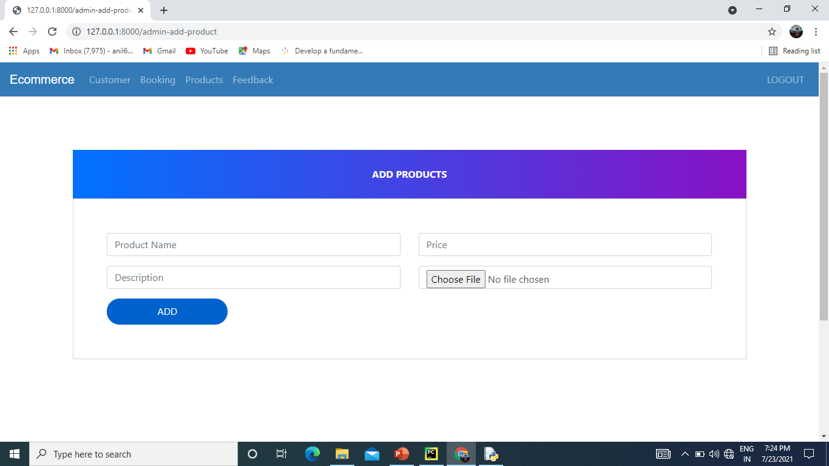
Product update

Slide 38
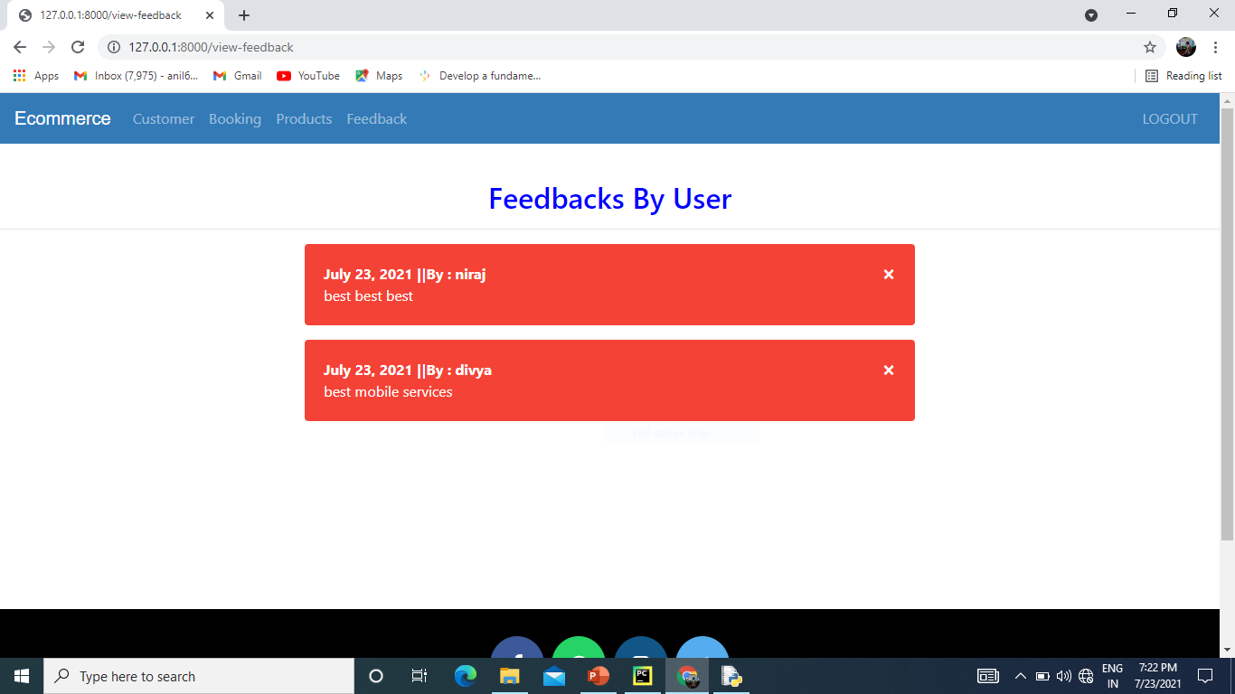
Product update

Slide 39
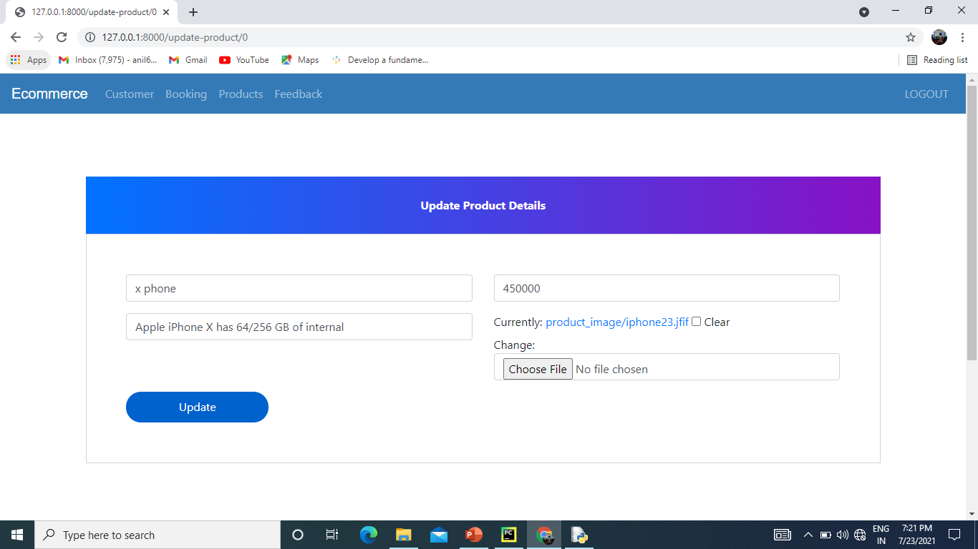
Update Product

Slide 40
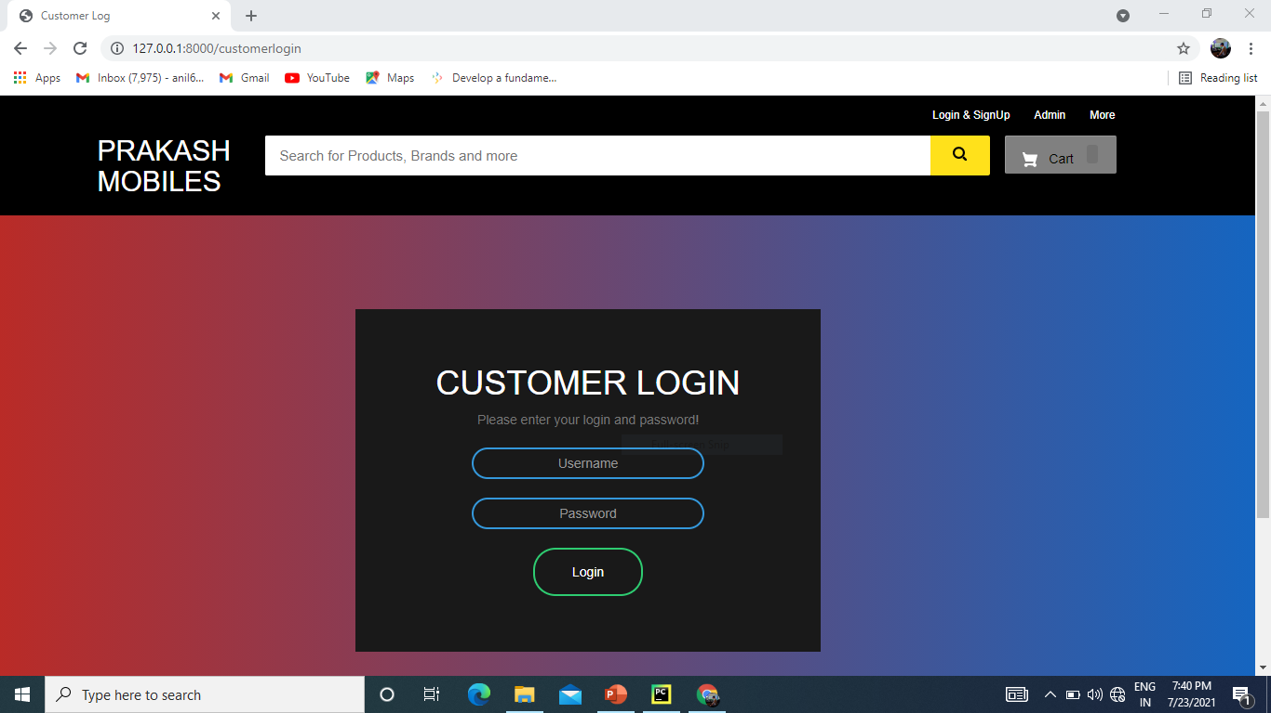
Customer Login

Slide 41
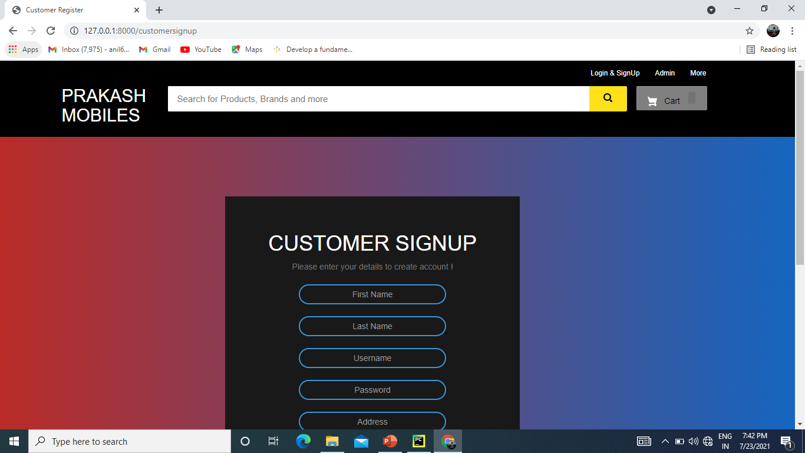
Signup

Slide 42
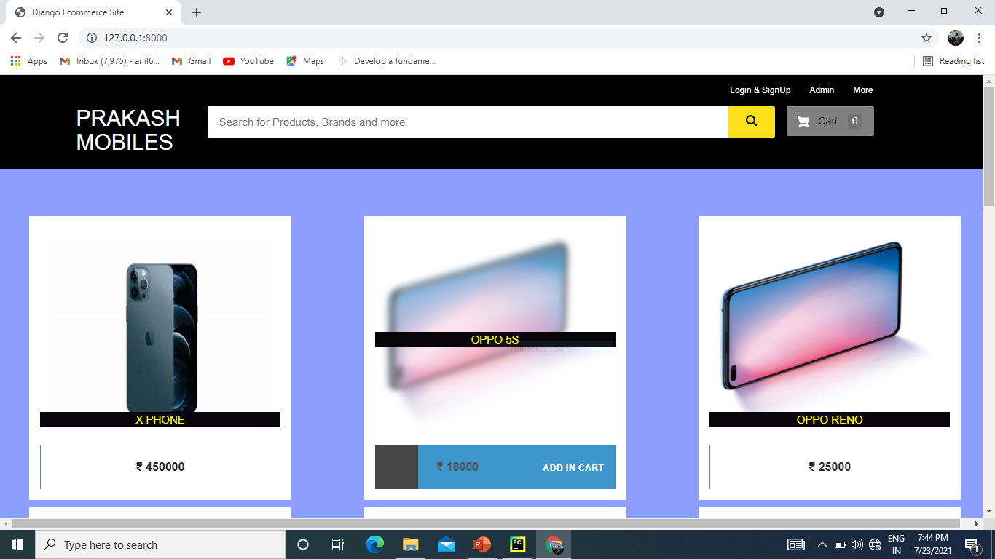
Main Booking

Slide 43
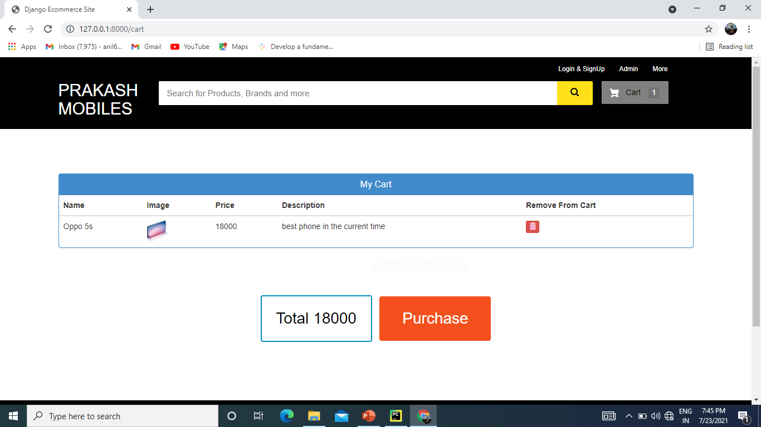
Cart

Slide 44
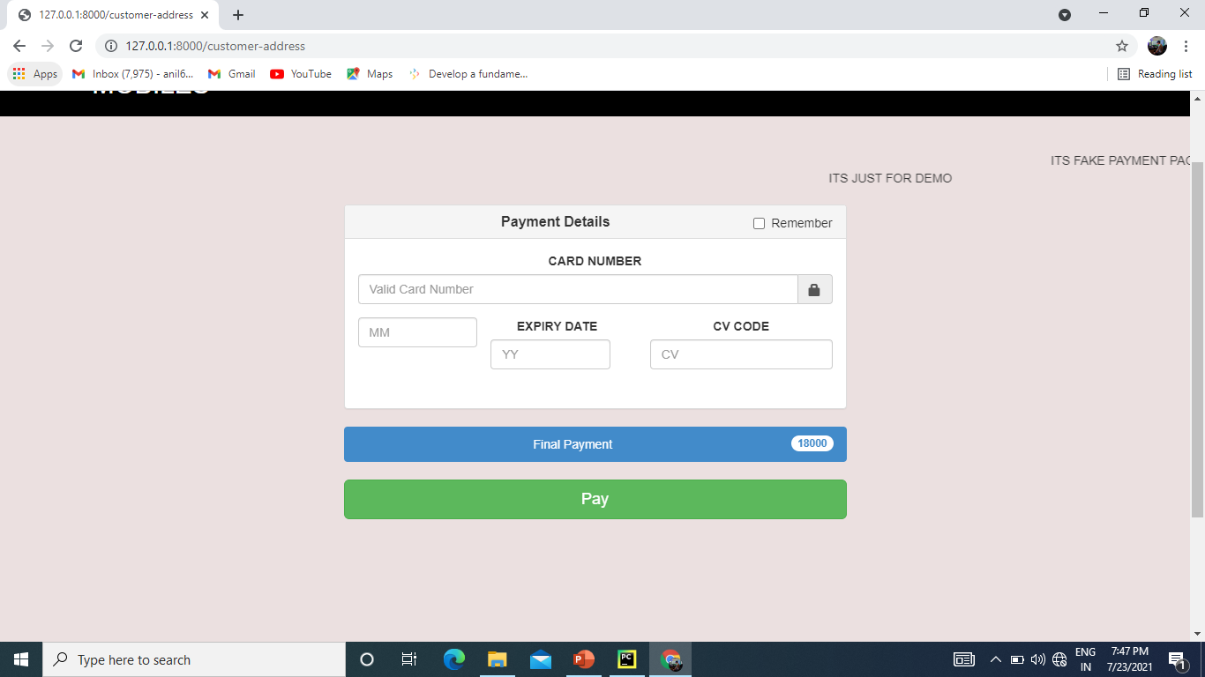
Card details

Slide 45
Future Enhancement
All the login system update use of open cv the automatic deduct the user and open the login system.
Recommendation of the product.
Promocode system.
QR Code system , And Advance Searching technique.

Slide 46

Thank You!

